Slide 1

© 2002, Cisco Systems, Inc. All rights reserved.

Slide 2

Configuring Serial
Point-to-Point Encapsulation
© 2002, Cisco Systems, Inc. All rights reserved.
Notes:
Purpose: This chapter introduces the Cisco IOS™ CLI on the Catalyst® 1900 switch and router.
Timing: This chapter should take about 2 hours to present.
Note: The Catalyst 1900 switch only has a subset of the router Cisco IOS commands available.
Contents:
Introduction to Cisco IOS. Explain to the student what is IOS?
Cisco Device startup procedures in general.
IOS configuration source.
General introduction to the IOS CLI.
Cat 1900 switch startup procedures.
Intro to Cat 1900 CLI. This part covers the basic configuration on the switch, like setting the IP address and hostname. More details about the various Cat 1900 switch configuration commands are explained in Chapter 6 and 7.
Router startup procedures. More details on the router startup process is discussed in chapter 5.
Router IOS CLI.

Slide 3
Objectives
Upon completing this lesson, you will be able to:
  Use Cisco IOS commands to configure serial interfaces using HDLC and PPP encapsulation for leased-line connections, given a functioning router
  Use show commands to identify anomalies in HDLC and PPP encapsulation for leased-line connections, given an operational router
  Use debug commands to identify events and anomalies in PPP configuration for leased-line connections, given an operational router
Notes:
Slide 1 of 2
Purpose: This slide states the chapter objectives.
Emphasize: Read or state each objective so that each student has a clear understanding of the chapter objectives.
Note: Catalyst switches have different CLIs. The Catalyst 2900xl and the Catalyst 1900 has a Cisco IOS CLI. The Cisco IOS CLI commands available on the 2900xl is different from the 1900. The Catalyst 5000 family has no Cisco IOS CLI, and use the set commands instead. This class only covers the configuration on the Catalyst 1900 switch.

Slide 4
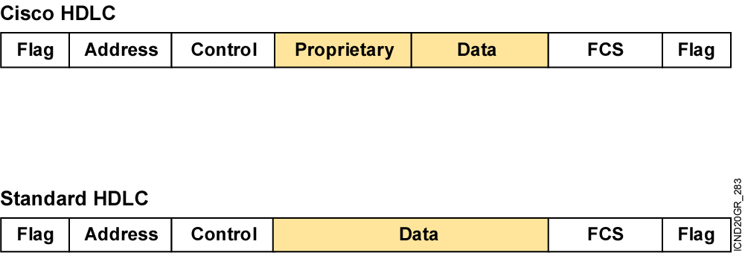
HDLC Frame Format
Uses a proprietary data field to support
multiprotocol environments
Supports only single-protocol environments
Notes:
Purpose: This figure introduces students to HDLC encapsulation.
Emphasize: HDLC is the default Layer 2 protocol for Cisco router serial interfaces. Cisco’s proprietary enhancement to HDLC incorporates a protocol or type field to allow multiple protocols to be carried on a single link.

Slide 5
Configuring HDLC Encapsulation
Router(config-if)#encapsulation hdlc
Enables HDLC encapsulation
Uses the default encapsulation on synchronous serial interfaces
Notes:
Purpose: This figure describes how to configure HDLC on a serial connection.
Emphasize: The encapsulation hdlc command is the default encapsulation on a Cisco router’s serial connection.
Transition: If the network consists of Cisco and non-Cisco devices, you should use PPP instead of HDLC.

Slide 6
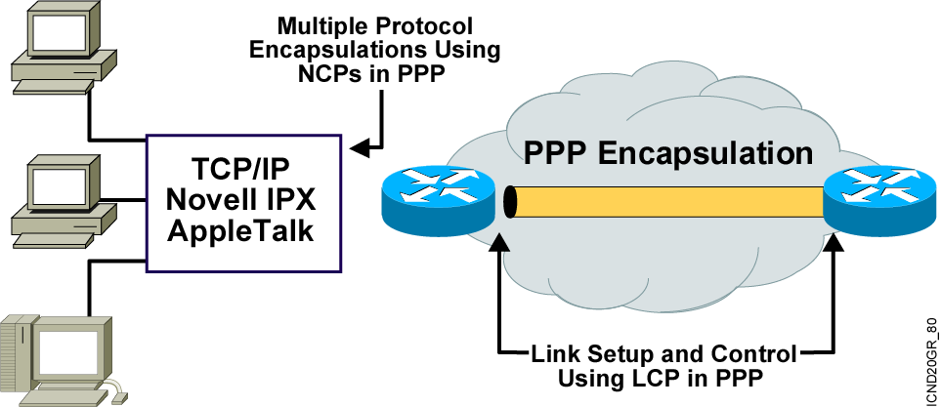
An Overview of PPP
PPP can carry packets from several protocol suites
using NCP.
PPP controls the setup of several link options using LCP.
Notes:
Purpose: This figure presents an overview of PPP.
Emphasize: The figure illustrates the multiple protocols that NCP supports.
The two arrows pointing to the router interfaces are where PPP encapsulation occurs.
The first bullet summarizes the role of NCP. The second bullet summarizes the role of the LCP options that the administrator can use to set up and control the data link.
Several RFCs are used to specify aspects of PPP. RFC 1548 is the major specification for the major PPP NCP and LCP operations.

Slide 7
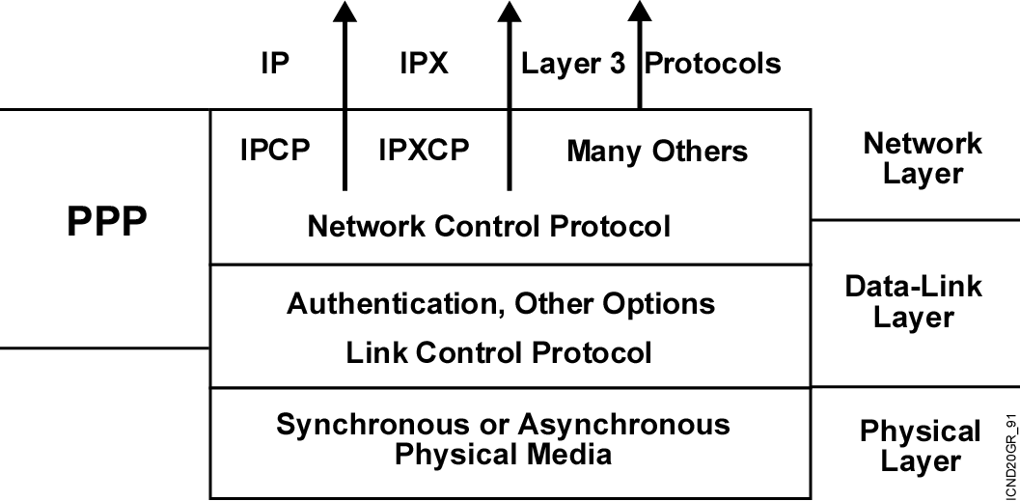
Layering PPP Elements
PPP: A data link with network layer services
Notes:
Purpose: This figure maps the elements of PPP to the OSI model.
Emphasize: At the bottom layer, PPP operates using synchronous media such as ISDN or asynchronous media such as basic telephone service dial-up. For ISDN, PPP operates over dial-up connections like those in a Cisco LAN2LAN Personal Office node, or over a link between two routers.
PPP offers data-link services that control access to communication media between devices considered directly connected over the WAN. This ISO/OSI Layer 2 protocol connects a DTE (local router) to another DTE (remote router).
Using PPP’s LCP options, an administrator can provide secure access and reliable data transfer.
PPP blends with many Layer 3 protocols using PPP NCPs. For example, in the ISDN lab that follows the next chapter, the router will use the IP Control Protocol (IPCP) with PPP encapsulation.

Slide 8
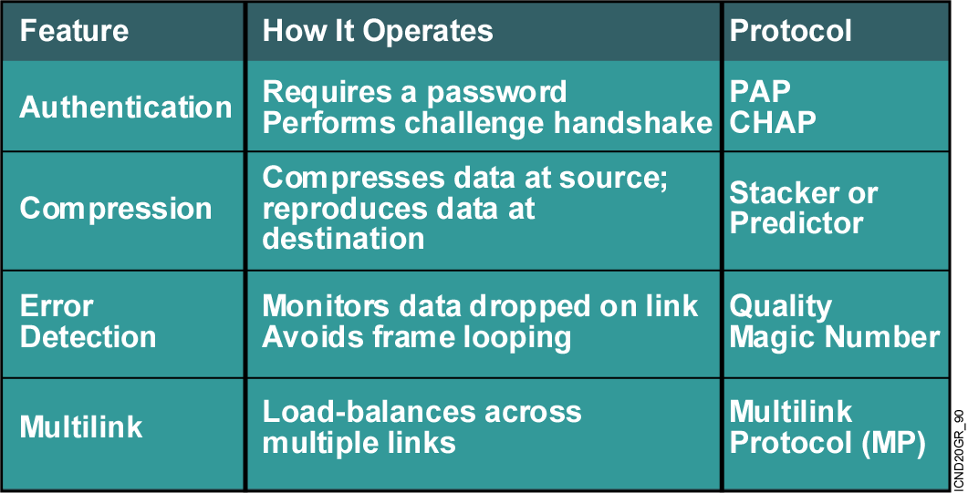
PPP LCP Configuration Options
Notes:
Purpose: The figure presents an overview of the most popular PPP features.
Emphasize: The table in the figure lists and describes the various LCP options.
PPP compression is offered in Cisco’s Compression Control Protocol (CCP).
RFC 1548 covers the IETF-approved PPP options in detail. RFC 1717 defines the Multilink Protocol. RFC 1990, The PPP Multilink Protocol (MP), obsoletes RFC 1717.
Note: To further enhance security, Cisco IOS™ Release 11.1 offers callback over PPP. With this LCP option, a Cisco router can act as a callback client or as a callback server.
The client makes the initial DDR call requests that it be called back, and terminates its initial call. The callback server answers the initial call and makes the return call to the client based on its configuration statements.
This option is described in RFC 1570.
Reference: Students will only learn how to configure PAP and CHAP authentication in this course. To learn how to configure the other LCP options, students should attend the Building Cisco Remote Access (BCRAN) course.

Slide 9
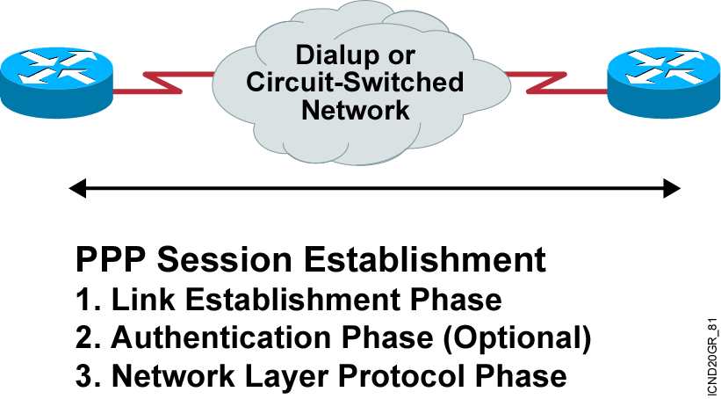
PPP Session Establishment
Two PPP authentication protocols:
PAP and CHAP
Notes:
Purpose: This graphic presents the PPP authentication overview.
Emphasize: A PPP session establishment has three phases, as follows:
Link establishment phase—In this phase, each PPP device sends LCP packets to configure and test the data link.
Authentication phase (optional)—After the link has been established and the authentication protocol decided on, the peer may be authenticated.
PPP supports two authentication protocols: PAP and CHAP.
Both of these protocols are detailed in RFC 1334, PPP Authentication Protocols. However, RFC 1994, PPP Challenge Handshake Authentication Protocol, obsoletes RFC 1334.
Network-layer protocol phase—In this phase, the PPP devices send NCP packets to choose and configure one or more network-layer protocol.

Slide 10
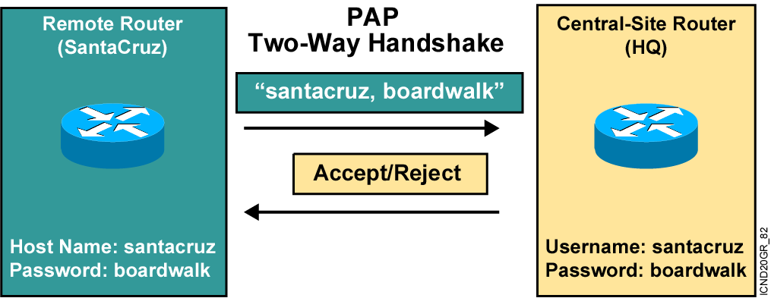
PPP Authentication Protocols
Passwords sent in clear text
Peer in control of attempts
Notes:
Slide 1 of 2
Purpose: This figure presents the PPP authentication protocol, PAP.
Emphasize: PPP sets line controls for the call.
There are two types of authentication protocols: PAP and CHAP.
PAP provides a simple method for a remote node to establish its identity using a two-way handshake.
PAP is done only upon initial link establishment.
PAP is not a strong authentication protocol. It provides no encryption. It may be fine in DDR environments when the password changes each time a user authenticates.
CHAP is the preferred protocol.

Slide 11
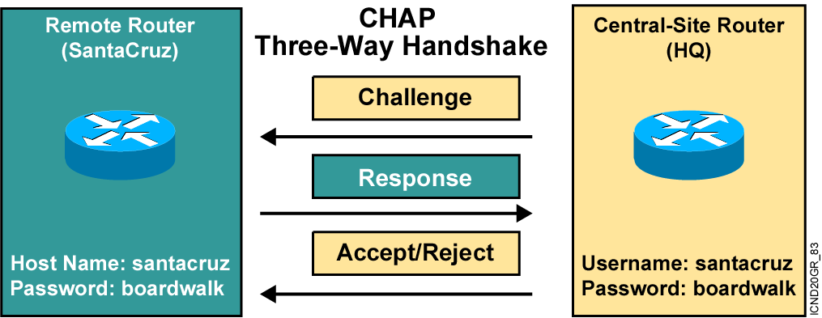
Challenge Handshake Authentication Protocol
Hash values, not actual passwords, are sent across link.
The local router or external server is in control of attempts.
Notes:
Slide 2 of 2
Purpose: This figure presents the PPP authentication protocol, CHAP.
Emphasize: CHAP is done upon initial link establishment and can be repeated any time after the link has been established.
CHAP transactions occur only when a link is established. The local access server does not request a password during the rest of the session. (The local access server can, however, respond to such requests from other devices during a session.)
CHAP is specified in RFC 1334. It is an additional authentication phase of the PPP Link Control Protocol.
Transition: Now that you know how PPP and PPP authentication operate, the following section describes how to configure these on a Cisco IOS router.

Slide 12
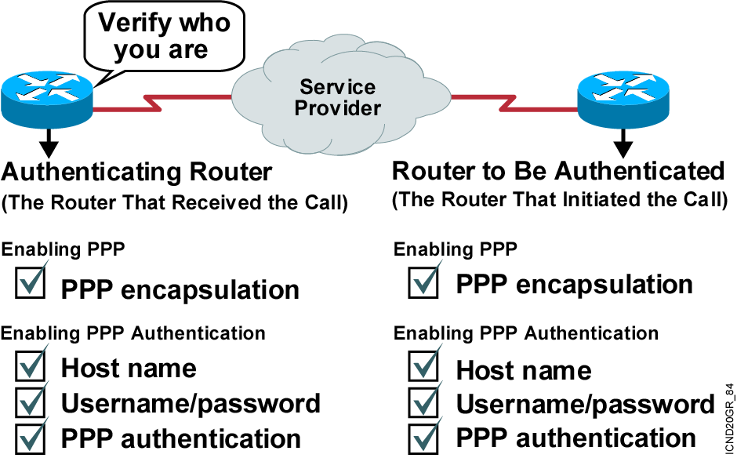
Configuring PPP and Authentication Overview
Notes:
Purpose: This figure provides a signpost highlighting the tasks you complete to enable PPP and PPP authentication.
Emphasize: Highlight the steps the student must take to enable PPP authentication.

Slide 13
Configuring PPP
Router(config-if)#encapsulation ppp
Enables PPP encapsulation
Notes:
Purpose: This figure describes how to encapsulate PPP on an interface.

Slide 14
Configuring PPP
Authentication
Router(config)#hostname name
Assigns a host name to your router
Router(config)#username name password password
Identifies the username and password of remote router
Notes:
Slide 1 of 2
Purpose: This figure describes how to set the host name on the local device, and a remote device’s username and password.
Emphasize: Correct configuration is essential since PAP and CHAP will use these parameters to authenticate. The names and password are case sensitive.

Slide 15
Configuring PPP
Authentication (Cont.)
Router(config-if)#ppp authentication
{chap | chap pap | pap chap | pap}
Enables PAP and/or CHAP authentication
Notes:
Slide 2 of 2
Purpose: This figure continues with the PPP authentication configuration commands.
Emphasize: If both PAP and CHAP are enabled, then the first method specified will be requested during link negotiation. If the peer suggests using the second method or simply refuses the first method, then the second method will be tried.

Slide 16
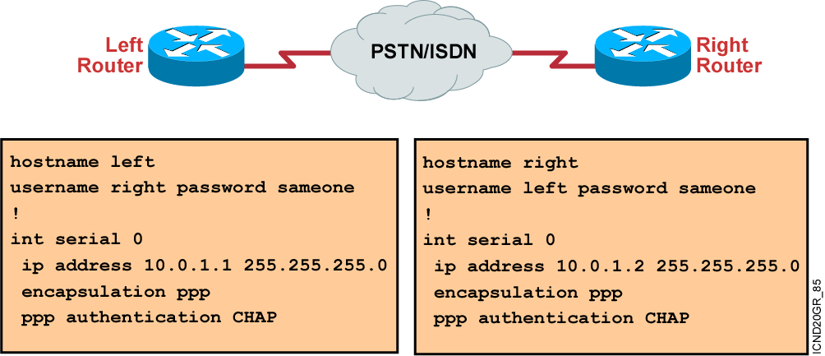
CHAP Configuration Example
Notes:
Purpose: This page shows an example of CHAP configuration between two routers.
Emphasize: When you configure the usernames and passwords for the local databases, the passwords on both systems must be identical. Usernames and passwords are case sensitive.
Transition: The next section shows how to verify that the connection is operating as intended.

Slide 17
Verifying the HDLC and PPP Encapsulation Configuration
Router#show interface s0
Serial0 is up, line protocol is up
Hardware is HD64570
Internet address is 10.140.1.2/24
MTU 1500 bytes, BW 1544 Kbit, DLY 20000 usec, rely 255/255, load 1/255
Encapsulation PPP, loopback not set, keepalive set (10 sec)
LCP Open
Open: IPCP, CDPCP
Last input 00:00:05, output 00:00:05, output hang never
Last clearing of "show interface" counters never
Queueing strategy: fifo
Output queue 0/40, 0 drops; input queue 0/75, 0 drops
5 minute input rate 0 bits/sec, 0 packets/sec
5 minute output rate 0 bits/sec, 0 packets/sec
38021 packets input, 5656110 bytes, 0 no buffer
Received 23488 broadcasts, 0 runts, 0 giants, 0 throttles
0 input errors, 0 CRC, 0 frame, 0 overrun, 0 ignored, 0 abort
38097 packets output, 2135697 bytes, 0 underruns
0 output errors, 0 collisions, 6045 interface resets
0 output buffer failures, 0 output buffers swapped out
482 carrier transitions
DCD=up DSR=up DTR=up RTS=up CTS=up
Notes:
Purpose: This graphic presents the show interface command, which is used to verify that PPP encapsulation is configured on the interface. The same command is used to verify proper HDLC configuration.

Slide 18
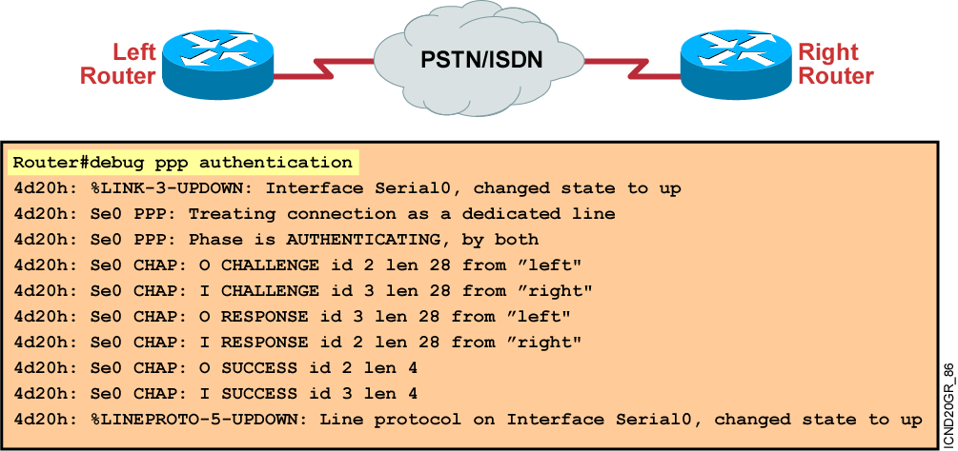
Verifying PPP Authentication
debug ppp authentication shows successful CHAP output.
Notes:
Purpose: This page shows an example of debug ppp authentication output. The output illustrates a successful CHAP authentication challenge.
Emphasize: The debug ppp authentication command displays the authentication exchange sequence as it occurs.

Slide 19
Summary
  HDLC is the Cisco default data-link layer protocol for encapsulating data on synchronous serial data links.
  PPP encapsulates network layer protocol information over point-to-point links.
  Configurable aspects of PPP include methods of authentication, compression, and error detection, as well as whether or not multilink is supported.
  PPP session establishment progresses through three phases: link establishment, authentication, and network layer protocol.
Notes:
Purpose: This slide discuss the initial configurations on the routers and switches.
Note: There is no setup mode on the Catalyst 1900 switch.

Slide 20
Summary (Cont.)
  When configuring PPP authentication, you can select PAP or CHAP. In general, CHAP is the preferred protocol.
  You enable PPP with the encapsulation ppp command and PPP authentication with the ppp authentication command.
  Use the show interface command to verify proper configuration of PPP encapsulation.
  The debug ppp authentication command displays the authentication exchange sequence.
Notes:
Purpose: This slide discuss the initial configurations on the routers and switches.
Note: There is no setup mode on the Catalyst 1900 switch.

Slide 21
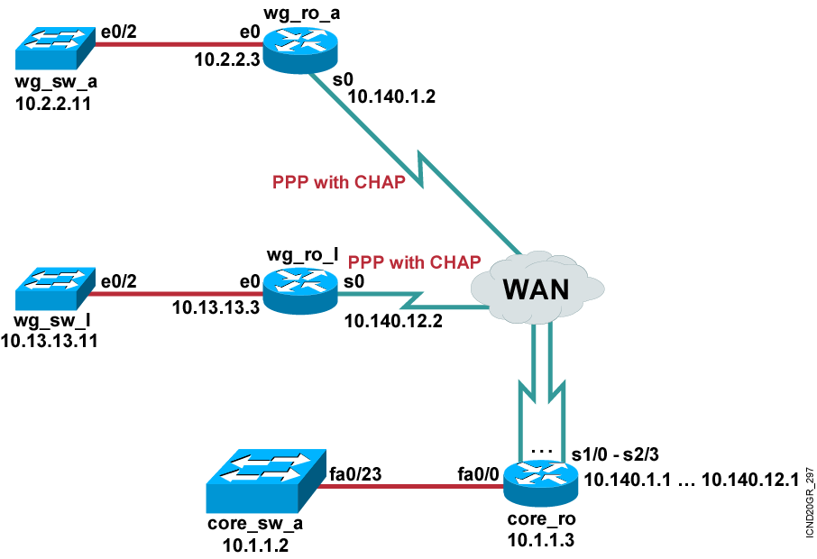
Visual Objective 7-1: Configuring Serial Connections to WAN Service Providers
Pod Router s0
A 10.140.1.2
B 10.140.2.2
C 10.140.3.2
D 10.140.4.2
E 10.140.5.2
F 10.140.6.2
G 10.140.7.2
H 10.140.8.2
I 10.140.9.2
J 10.140.10.2
K 10.140.11.2
L 10.140.12.2
Notes:
Lab 15 optional PPP
Objectives: Establish a serial point-to-point connection. Enable the PPP data link protocol on the connections.
Purpose: Teach students how to enable a point-to-point link.
Laboratory Instructions: Refer to the lab setup guide.

Slide 22


